Slide 1
Computer Basic Concepts
By:
Mr: Muhammad Faiz
Lecturer –Computer Science
SUKKUR IBA UNIVERSITY KANDHKOT CAMPUS

Slide 2
What is a computer
A computer is a general purpose machine, commonly consisting of digital circuitry, that accepts (inputs), stores, manipulates, and generates (outputs) data as numbers, text, graphics, voice, video files, accordance with instructions.
A computer is an electronic device that manipulates information, or data to produce some result. It has the ability to store, retrieve, and process data. You can use a computer to type documents, send email, and browse the Web. You can also use it to handle spreadsheets, accounting, presentations, games, and much more.

Slide 3
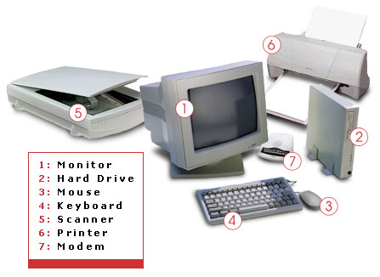
Computer Hardware
Hardware is best described as a device that is physically connected to the computer or something that can be physically touch and see.
Hardware carries out tasks instructed by the software.
A key board, monitor, printer, and video card are all examples of computer hardware.
Without any hardware your computer would not exist.

Slide 4
Types of computers
Digital Computers:
Digital computer operates on digital data such as numbers.
It uses binary number system in which there are only two digits 0 and 1. Each one is called a bit.
Digital Computers can give more accurate and faster results.
Hence digital computers have an increasing use in the field of design, research and data processing.
Analog Computers:
Analog Computer is a computers works on continuous range of values.
The results given by the analog computers will only be approximate since they deal with quantities that vary continuously.
It generally deals with physical variables such as voltage, pressure, temperature, speed, etc.

Slide 5
Types of computers ……….
Hybrid Computers:
A hybrid computer combines the desirable features of analog and digital computers.
It is mostly used for automatic operations of complicated physical processes and machines.
For example, in hospital’s ICU, analog devices might measure the patients temperature, blood pressure and other vital signs.
These measurements which are in analog might then be converted into numbers and supplied to digital components in the system.
These components are used to monitor the patient’s vital sign and send signals if any abnormal readings are detected.
Hybrid computers are mainly used for specialized tasks.

Slide 6
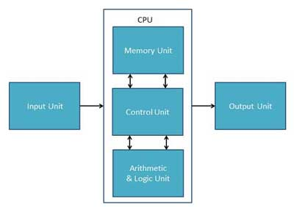
Structure of Computer

Slide 7
Component of Computer
Central Processing Unit (CPU):
The central processing unit (CPU), is considered as the brain of a computer.
The microprocessor is a multipurpose, programmable device that accepts digital data as input, processes it according to instructions stored in its memory, and provides results as output
Its primary function is to process data at extremely fast rates,
The CPU speed is referred to as GH_{z}. The higher the CPU speed, the more data can be processed.
The size of a CPU is referred to in bits.

Slide 8
Central Processing Unit (CPU)
The Central Processing unit(CPU) that is normally inserted into the motherboard.
Sometimes also called the processor or microprocessor.
CPU also has a set of registers which are temporary storage areas for holding data, and instructions during processing.
Microprocessors operate on binary number system
Intel introduced its first 4-bit microprocessor 4004 in 1971.

Slide 9
Parts of CPU
Arithmetic Logic Unit
The arithmetic and logic unit of CPU is responsible for all arithmetic operations
like addition, subtraction, multiplication and division
ALU also performs logical operations. Such as less than, equal to and greater than.
All calculations and comparisons are performed in the arithmetic logic unit.
Control Unit
It is considered as the “Central Nervous System” of computer, as it manages and coordinates all the units of the computer.
The control unit is responsible for controlling the transfer of data and instructions among other units of a Computer.
It directs the flow of data between the Central Processing Unit (CPU) and the other devices.
All computer resources are managed by in a efficient manner by the CU (Control Unit).
Control unit also performs the data transfer between memory and the peripheral device.

Slide 10
Random Access Memory (RAM)
Temporarily hold the data and instructions.
A random-access device allows data to be accessed directly in random order
Volatile means all data stored in RAM disappears immediately after the computer is turned off.
The more memory you have the faster the computer will run.
It is faster than hard drive but smaller in size than hard drive.
Its also called Primary storage unit.
Measurement units: bytes (B), kilobytes (KB), megabytes (MB), gigabytes (GB)
Its also called (DRAM) is the most common kind of random access memory (RAM) used in desktop and laptop computers.
It looks like chip can be connected to slot at mother board.
DRAM stores its information in a cell containing a capacitor and transistor.

Slide 11
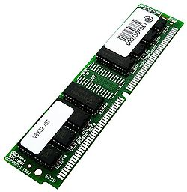
Random Access Memory (RAM)………..
What is a capacitor? It store electrical energy.
What is a transistor? transistor used to control the amount of current or voltage or used for amplification or switching of an electronic signal (short for transfer resistance) .
1 capacitor and transistor store one bit of data. either 1 or 0.
Inside a 1 ram chip there are millions of small capacitors & transistors

Slide 12
Read-only Memory (ROM)
ROM is "built-in" computer memory containing data that only can be read.
ROM is memory that cannot be edited or modified, it can only be read.
Non-volatile in nature.
Store the permanent information supplied by the manufacturer.
It is fixed or embedded with mother board.
ROM contains the programming that allows your computer to be "booted up.
Contain the bootstrap program which loads and initializes the operation system of the computer.
It also store (BIOS) program(basic input/output system).

Slide 13
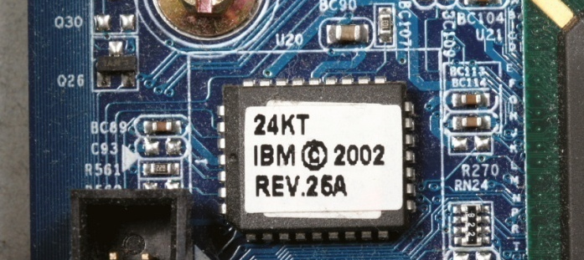
Read-only Memory (ROM)

Slide 14
Hard Disk/ Hard Drive
The hard drive (HDD) is a fundamental internal component for a computer, this is where all documents, music and movies are stored.
It is known as a Permanent storage device.
An HDD retains its data even when computer is powered off
Without it, One cannot access or save files. The hard drive is connected to the motherboard.
It is also called secondary storage device.The units used for hard drive is GB (gigabytes)
Data is read in a random-access manner, meaning individual blocks of data can be stored or retrieved in any order.
Introduced by IBM (The International Business Machines) in 1956.
An HDD consists of one or more rigid rotating disks (or platters with magnetic heads arm to read and write data to the surfaces

Slide 15
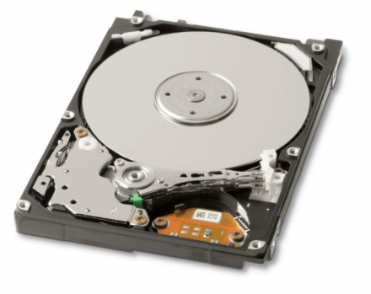
Hard Disk/ Hard Drive
Interfaces
IDE-Integrated Drive Electronics
SATA-Serial attachment

Slide 16
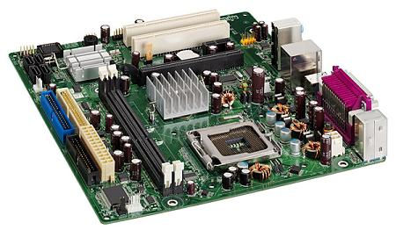
Motherboard
The motherboard is the part of the computer that links every other component together, therefore is one of the most vital parts of the computer.
Not specifically a component, but more like the main circuit board for the computer, connecting different devices together.
A motherboard is the backbone of a computer unit it makes communication between all other components within a computer.
It holds the CPU, RAM ROM Hard drive etc.

Slide 17
Thank You

